Slide 1
Analytics of Business Intelligence Project
By : Aryan Patel

Slide 2
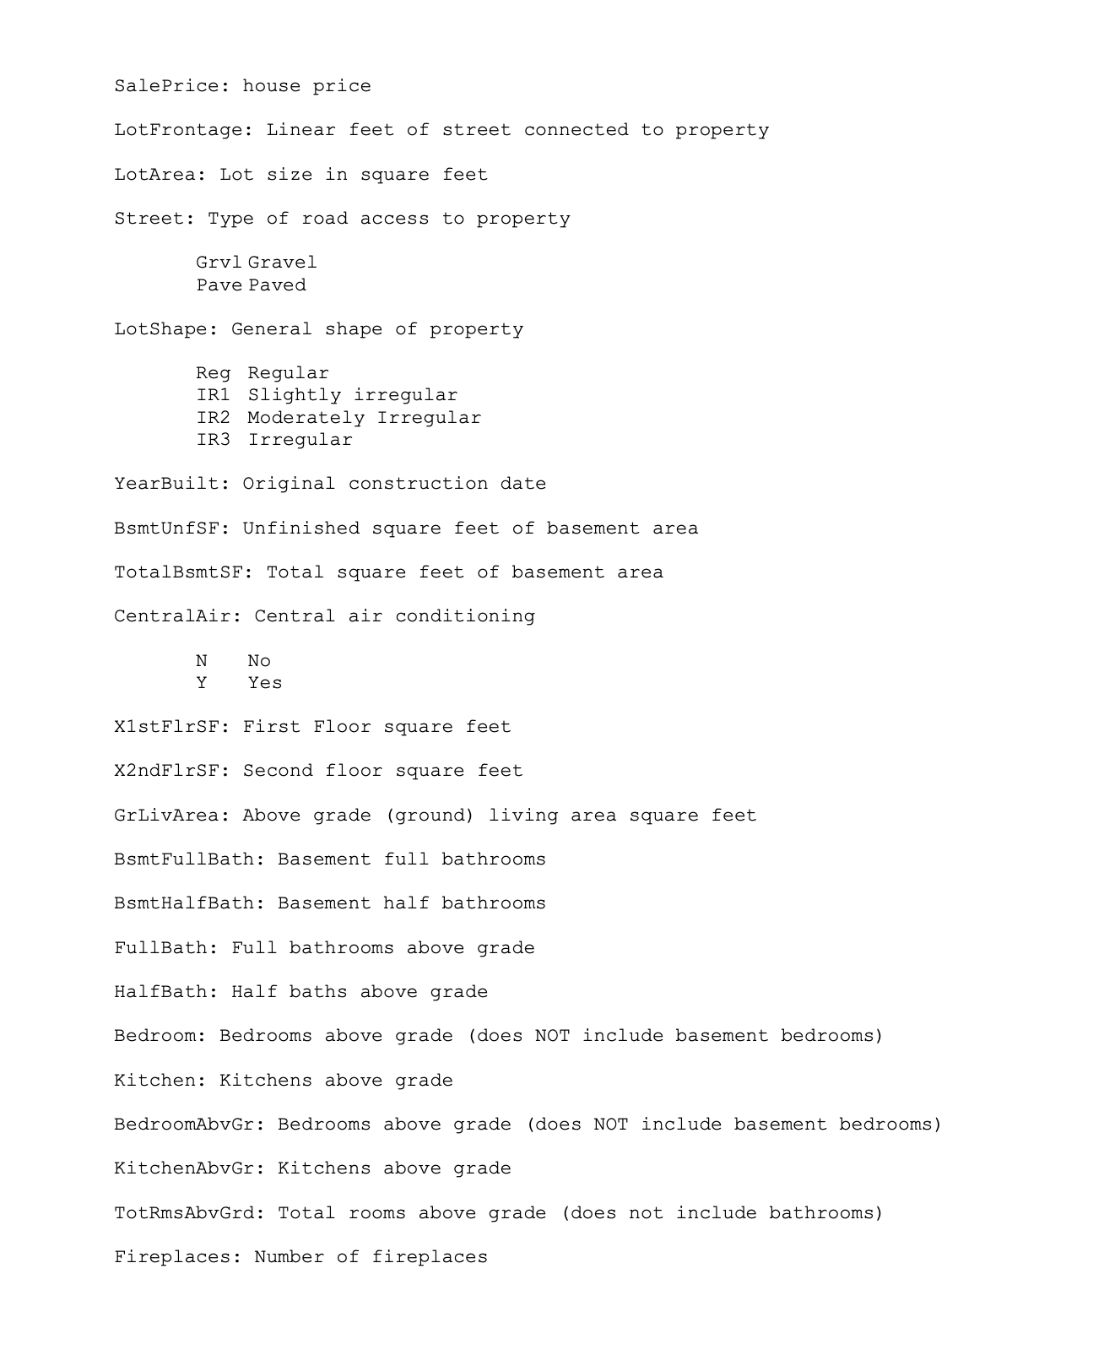
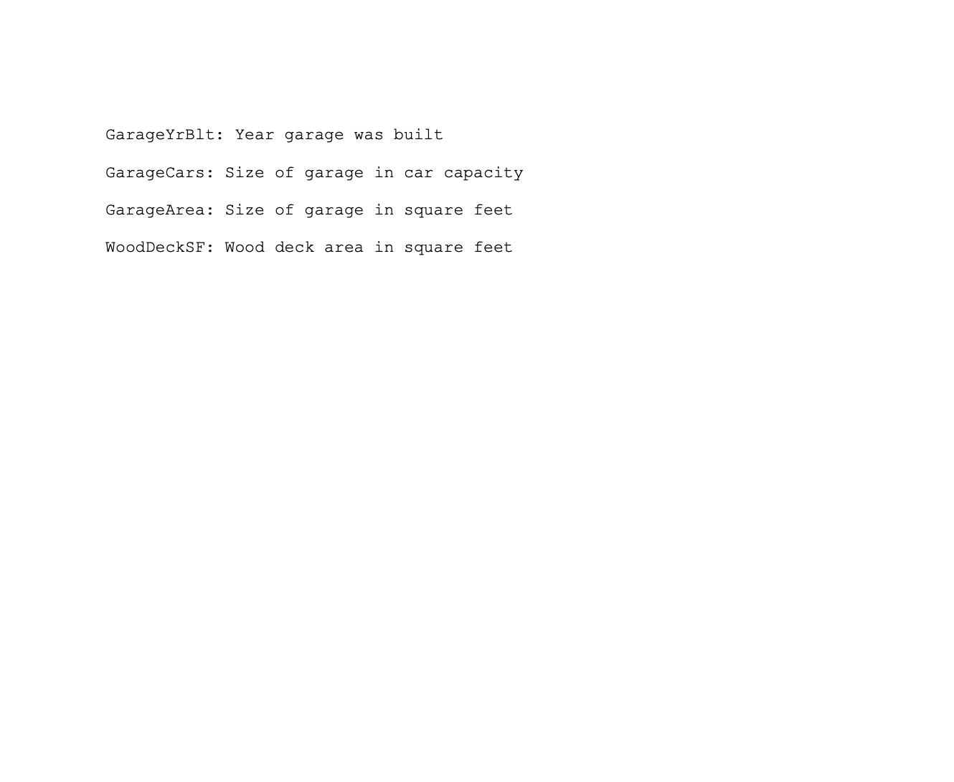
Data Description

Slide 3
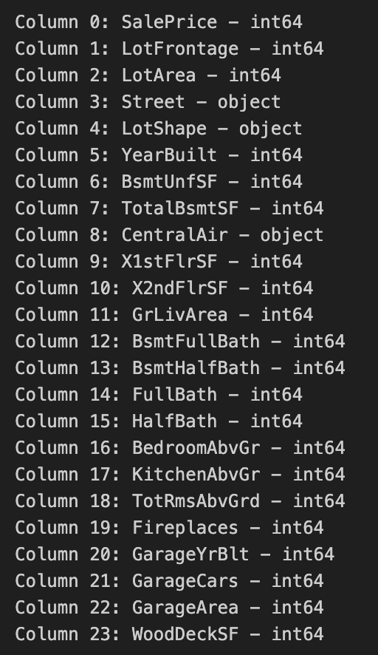
Data Description
Y = Log(SalesPrice)
X = All other variables
Training has 901 rows 24 columns
Test has 226 rows 24 columns

Slide 4

Data Cleaning/Processing
For Categorical Variables : One-hot encoding
For numeric variables : Standard Scalar
Split train and test into X and Y train test.

Slide 5
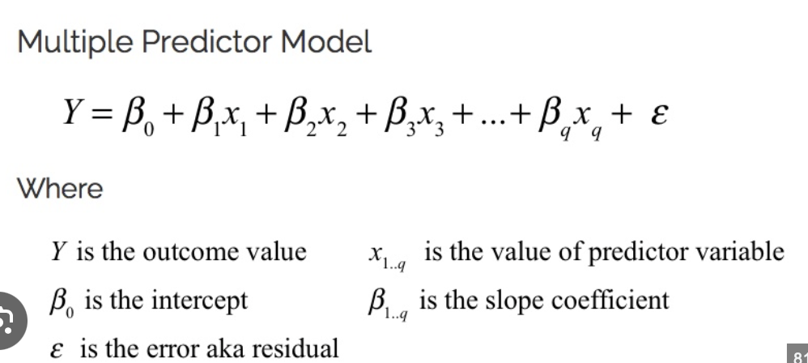
Model 0(BASE) : Multiple Linear Regression
Training MSE (Regular Regression) is : 0.02462790457299441 Test MSE (Regular Regression) is : 0.06428908586018621
0.0 seconds to run.

Slide 6
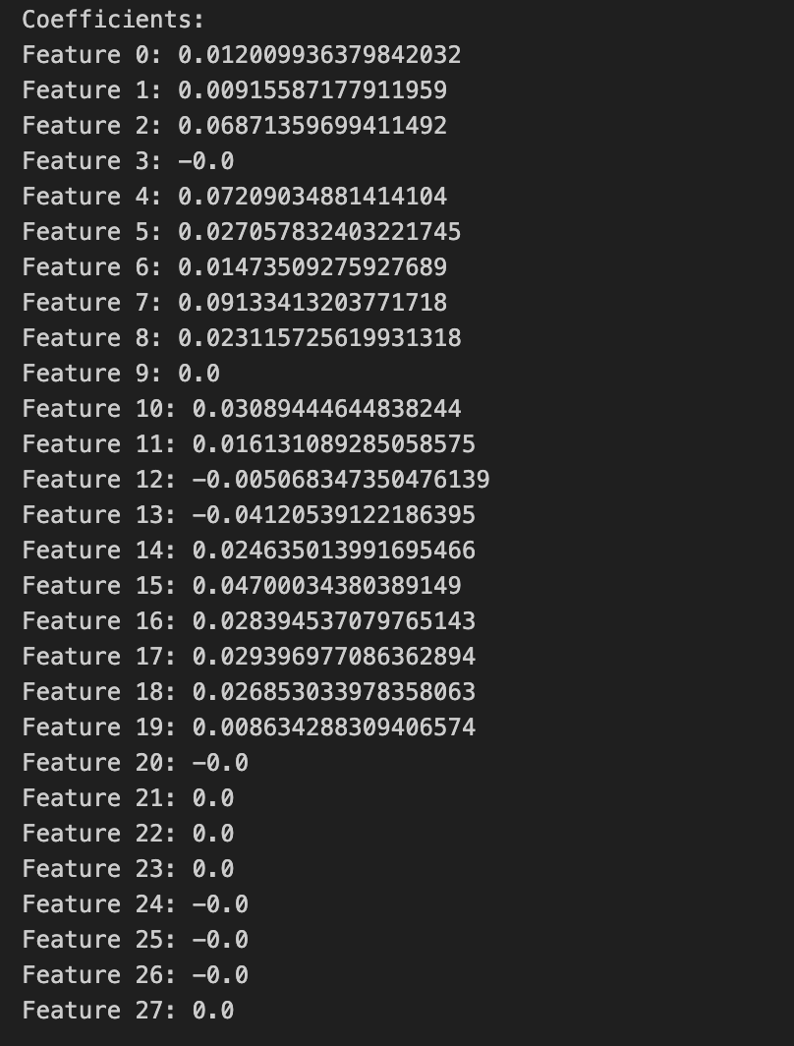

Model 1 : Elastic Net Regression
Implemented Elastic Net Regression with grid search cv to find best hyper param values.
Best Hyperparameters are : {'alpha': 0.1, 'l1_ratio': 0.1} Training MSE (Elastic Net) is : 0.027969114268482042 Test MSE (Elastic Net) is : 0.05836975904396832
0.4 seconds to run

Slide 7
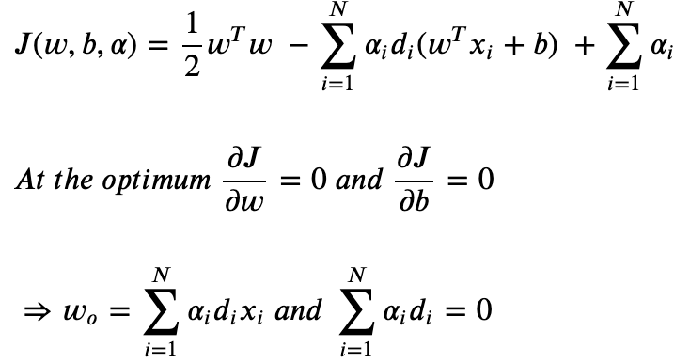
Model 2 : SVM
Training MSE (SVM): 0.009404704464279212 Test MSE (SVM): 0.02839727450036488 Best hyperparameters: {'C': 1, 'epsilon': 0.1}
The SVM model results in the best test mse out of the four models.
Time to run : 2.3 seconds.
Also used polynomial kernel with degree = 3 for best results compared to linear kernel or other degree poly kernels/

Slide 8
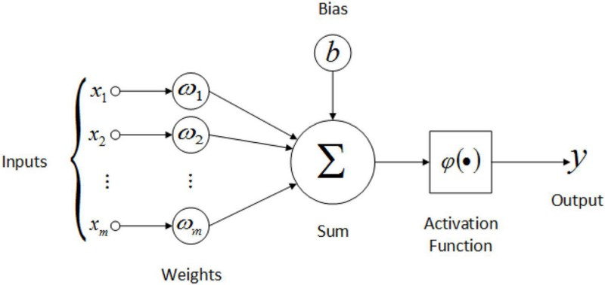
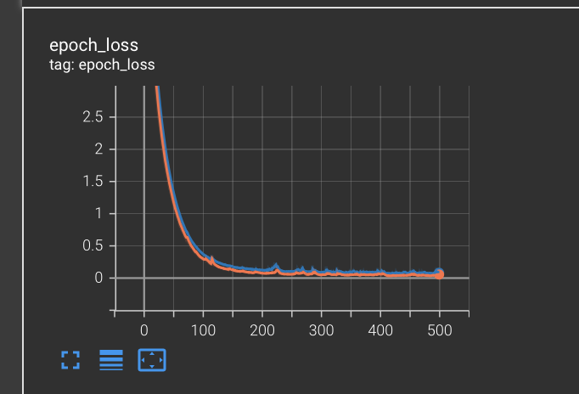
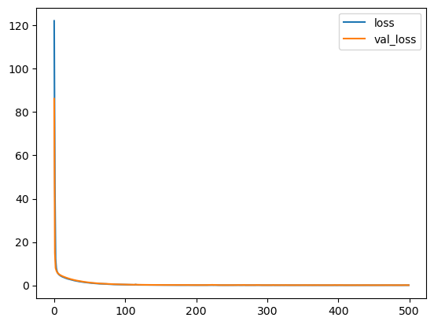
Model 3 : Neural network (Feedforward MLP)
Test MSE (NN): 0.05310422254079838

Slide 9
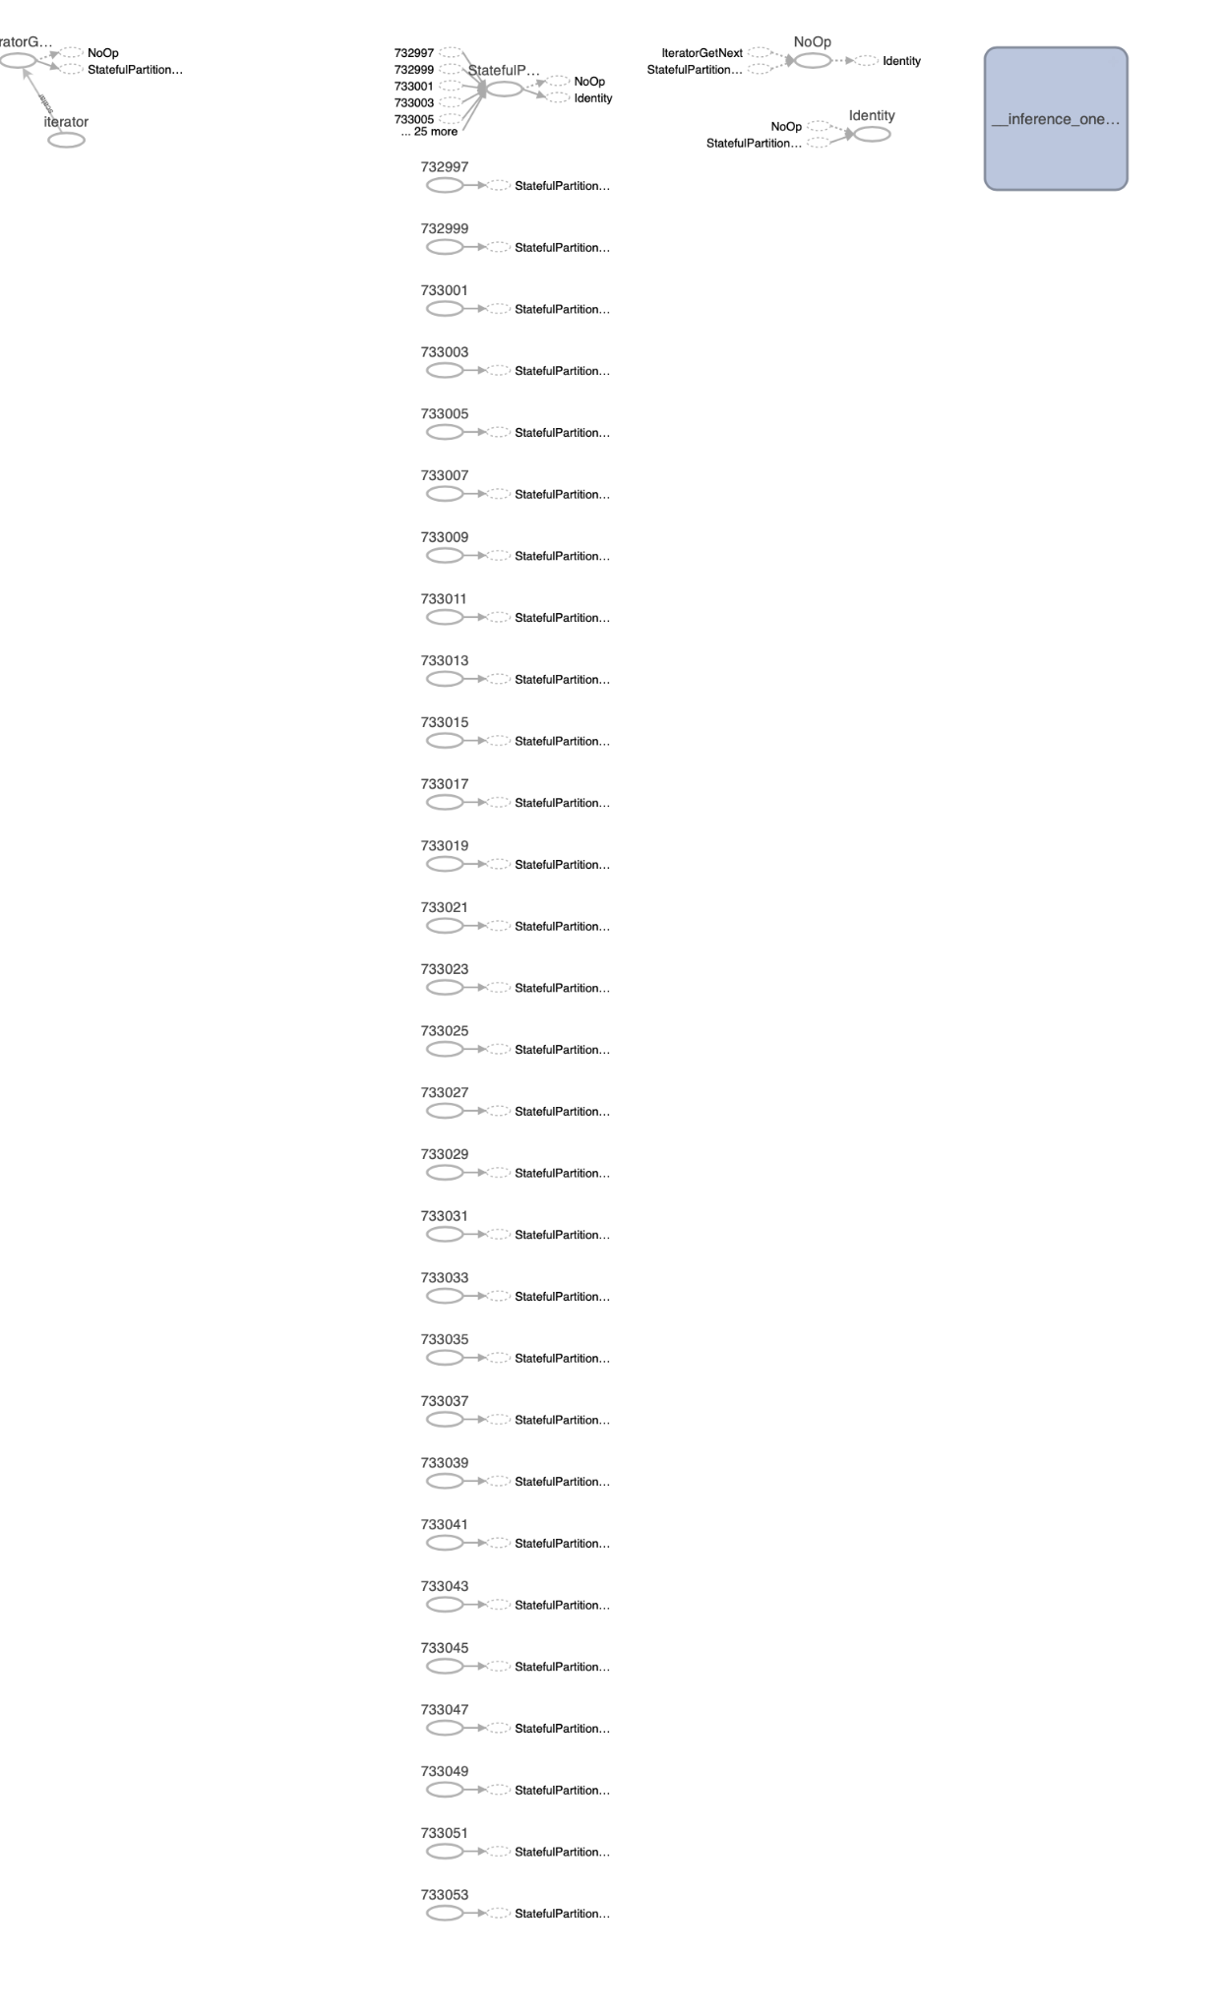
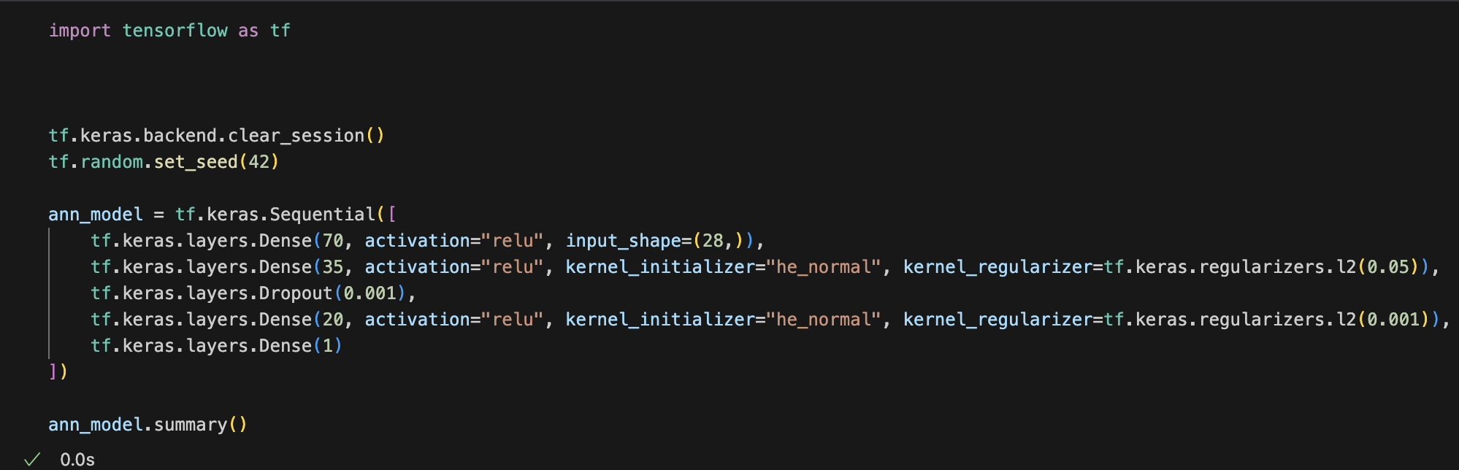
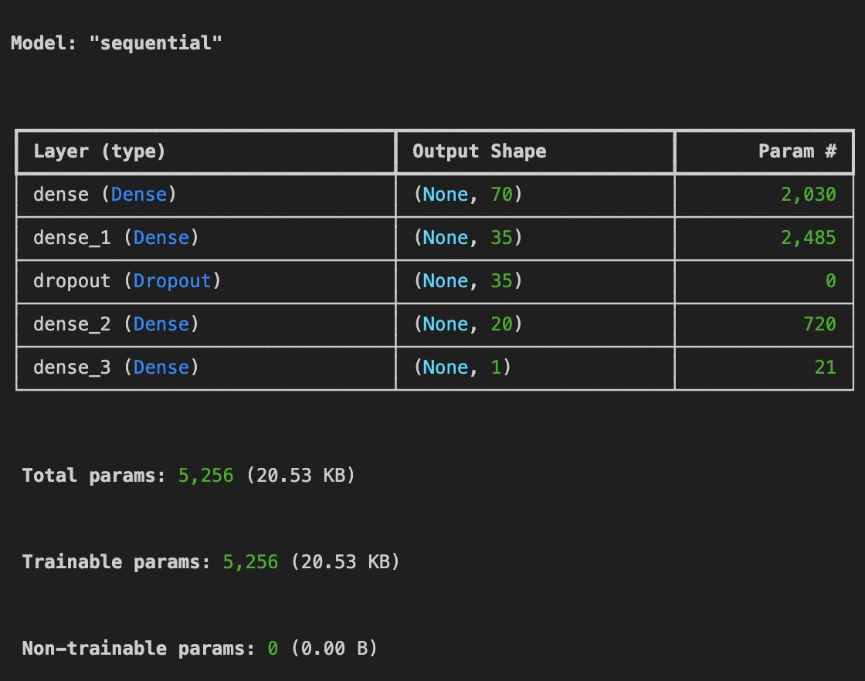
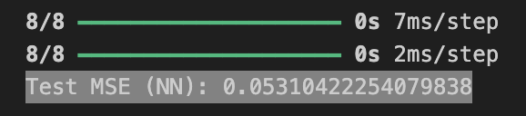
Model 3 neural network architecture
From tensor board

Slide 10
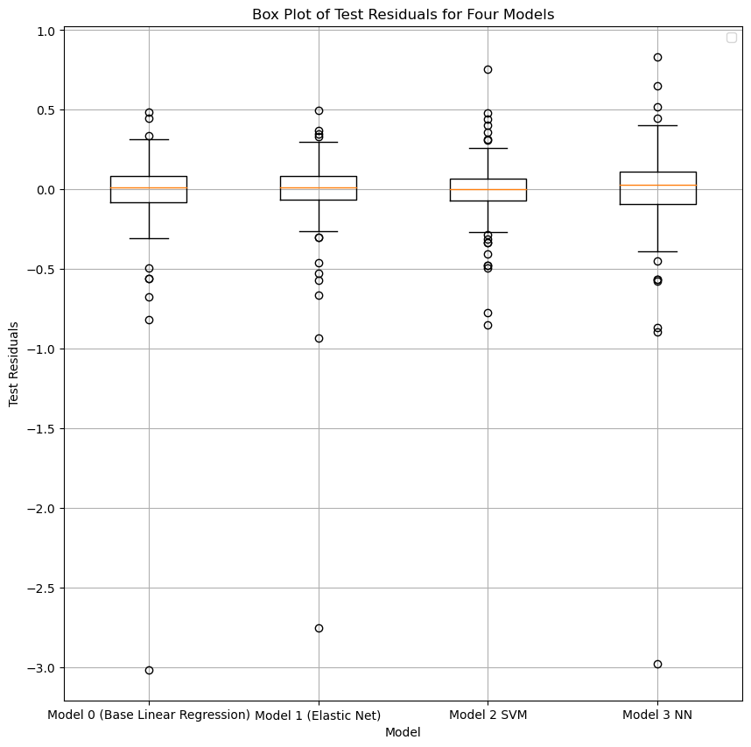
Residuals

Slide 11
Best Model
#1 In terms of how computationally expensive it is and accuracy, the SVM Model with poly kernel and degree set to 3 has around test mse of 0.02 in predicting the log(SalesPrice) and compiles in 2.3 Seconds.
Next will be elastic net which has test mse of 0.058 and compiles in 0.4 seconds
Next is Neural network (Feedforward MLP) with test mse of around 0.053 but takes around 1 minutes to compile.
Finally the worst model as predicted is the Base Multiple Regression Model

Slide 12

Question and Answer

